Slide 1

Predicting Used Car Prices with Machine Learning
This project aims to address the challenges in the dynamic used car market by developing a machine learning model to accurately predict used car prices. The goal is to improve market efficiency, ensure fair transactions, and foster customer satisfaction for car dealerships, individual sellers, and buyers. Using a dataset from an online car marketplace with over 300,000 records, the study implements various models to estimate car prices based on features such as brand, model year, mileage, engine type, and accident history.
Menna Mahmoud EL-Bagoury
Youmna Wael Muhammed
Mariem Naeim
ME

Slide 2

Problem Statement and Objectives
1
Market Complexity
2
Model Development
The used car market faces challenges in determining fair prices due to numerous influencing factors.
Develop a machine learning model to predict used car prices based on key features.
3
Factor Identification
4
Improved Accuracy
Identify the most influential factors affecting used car prices.
Enhance prediction accuracy compared to traditional pricing models or manual strategies.

Slide 3
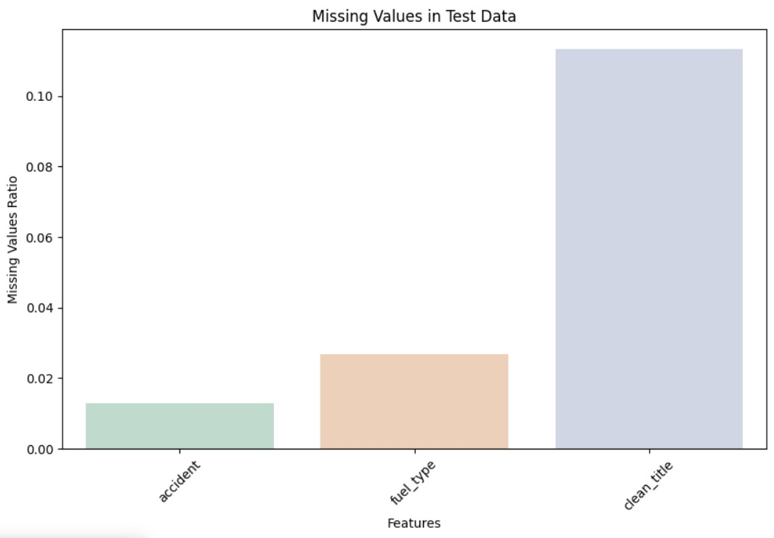

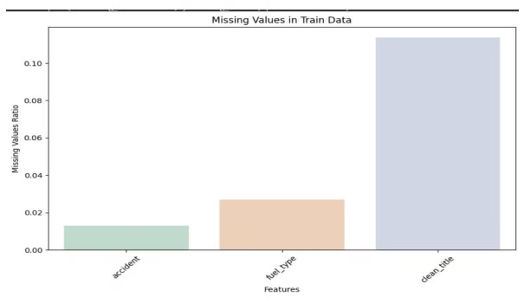
Dataset Overview
Training Dataset
188,533 records
Test Dataset
125,690 records
Total Columns
13
The dataset includes features such as id, brand, model, model year, mileage, fuel type, engine, transmission, exterior color, interior color, accident history, clean title status, and price. Several columns contained missing values that required handling during preprocessing.

Slide 4

Data Preprocessing
1
Missing Value Imputation
Handled missing values in fuel type, accident history, and clean title columns using iterative imputation techniques.
2
Feature Engineering
Created new features from the engine column, such as Horsepower and Displacement.
3
Encoding and Scaling
Applied one-hot encoding to categorical variables and standard scaling to continuous features.

Slide 5
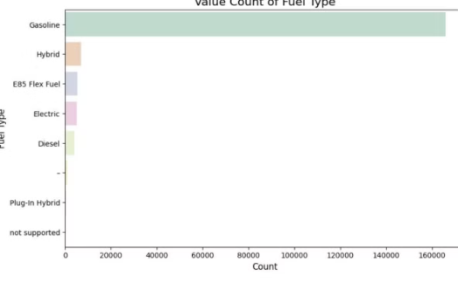
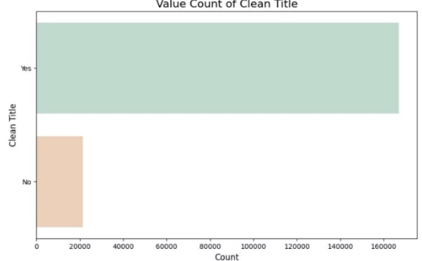
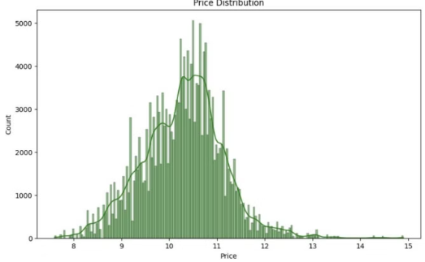
Exploratory Data Analysis
Fuel Type Distribution
Clean Title Status
Price Distribution
Analysis of the distribution of fuel types among the cars in the dataset.
Visualization of the clean title status distribution in the dataset.
Analysis of the price distribution across the used car dataset.

Slide 6
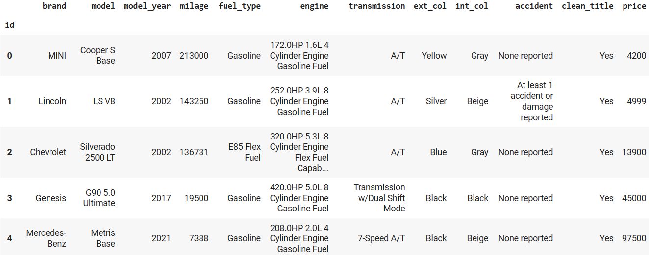
Table Before Data Preprocessing

Slide 7
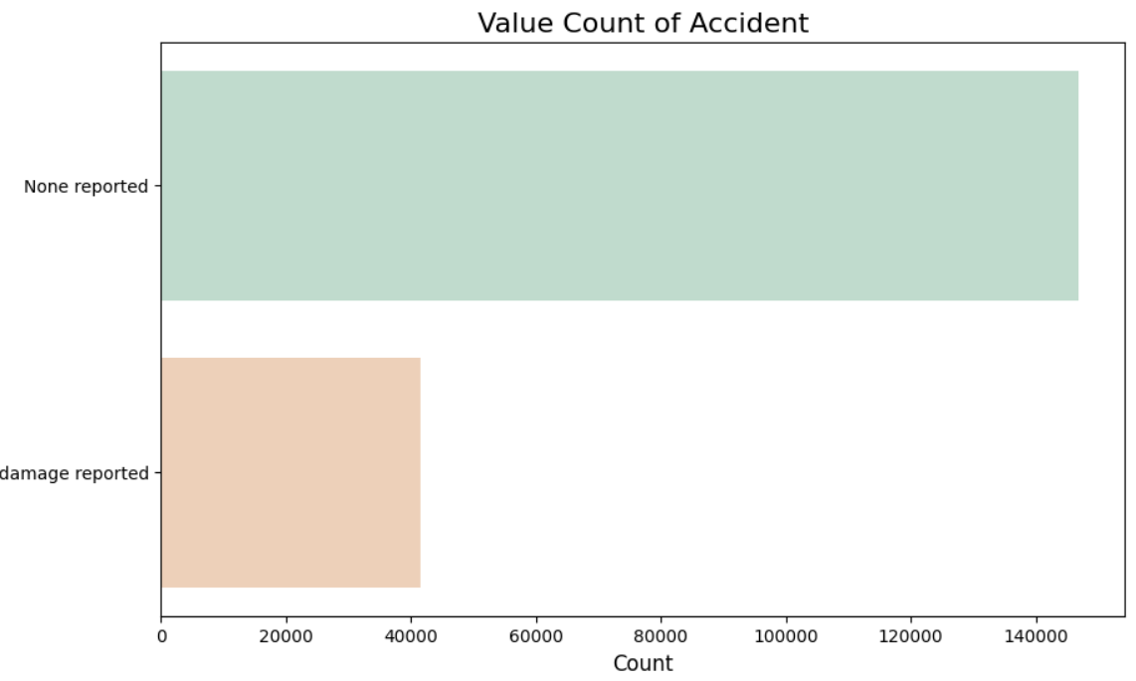
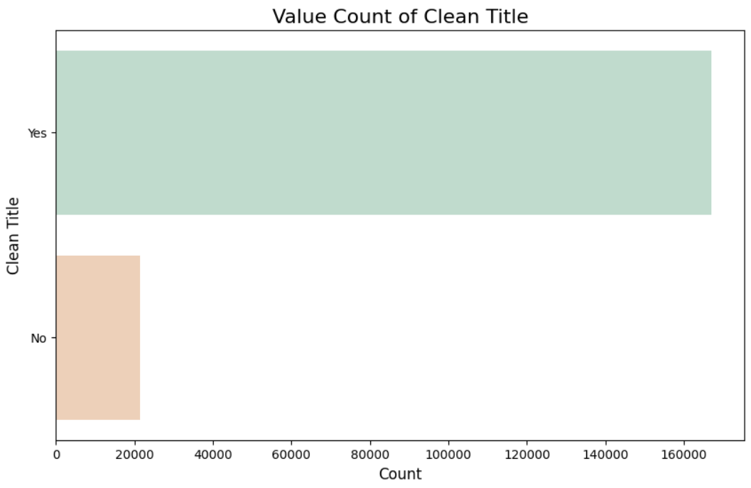
Dealing With Null Values
1- Null Values in “fuel_type”
is changed to “Electric”
2- Null Values in “clean”
is changed to “No”
3- Null Values in “accident”
is changed to “Non reported”

Slide 8
Data Preprocessing Summary
After dealing with null values:
1- Performing Feature Engineering using re library to deal with engine column and
derive four columns:
(horsepower, displacement, engine type, cylinder count)
2- Handling missing values of theses four columns using:
a. Simple Imputation for Cylinder Column
b. Iterative Imputation for “displacement” and “cylinder type”
3- One Hot Encoding for the Categorical Columns:
('brand', 'fuel_type’)
4- Scaling for the Continous columns:
('milage', 'Horsepower', 'Displacement', 'Cylinder Count', 'model_age’)

Slide 9
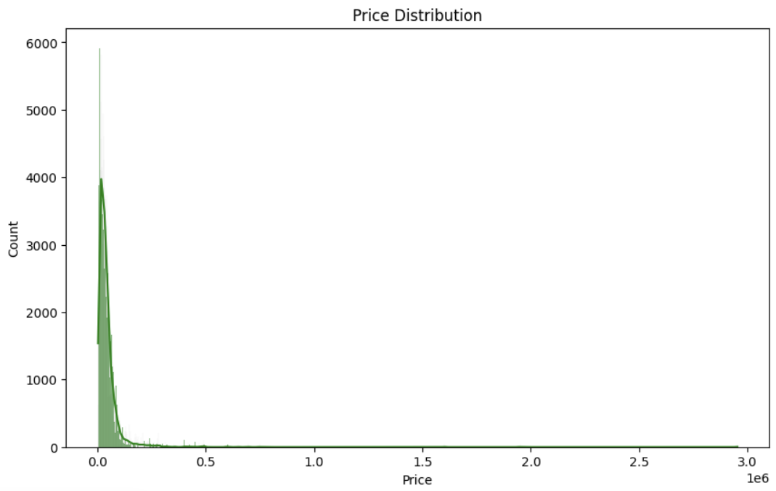
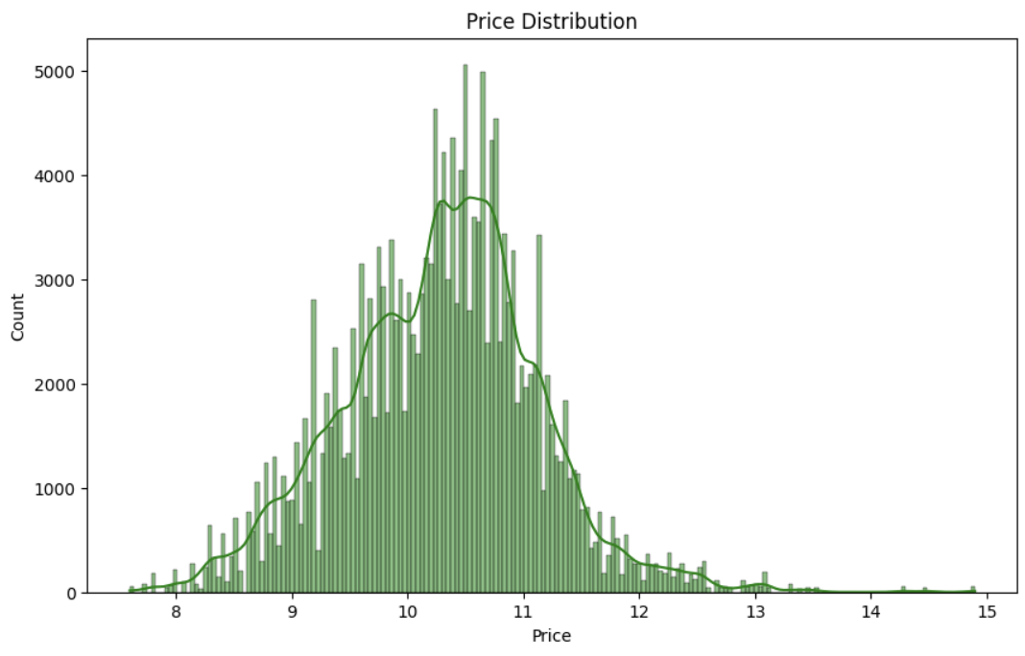
Log Transformation For Price

Slide 10
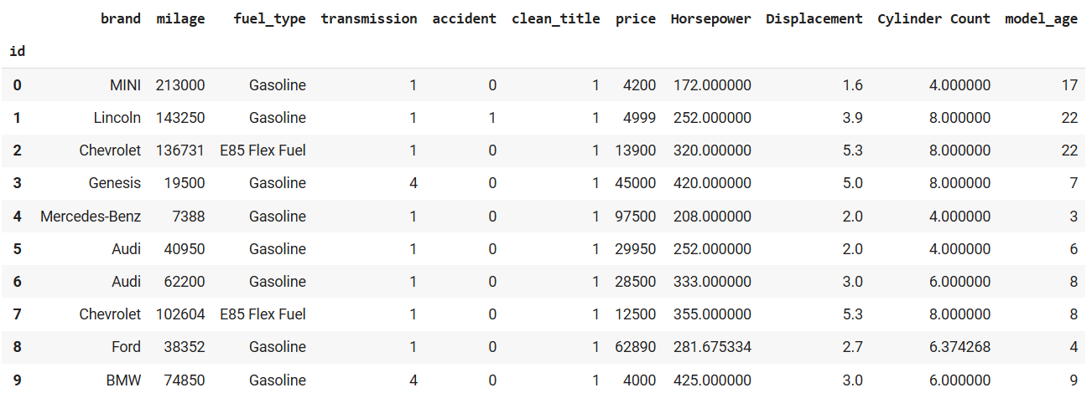
Table After Data Preprocessing
Note: Except For One Hot Encoding and Scaling

Slide 11
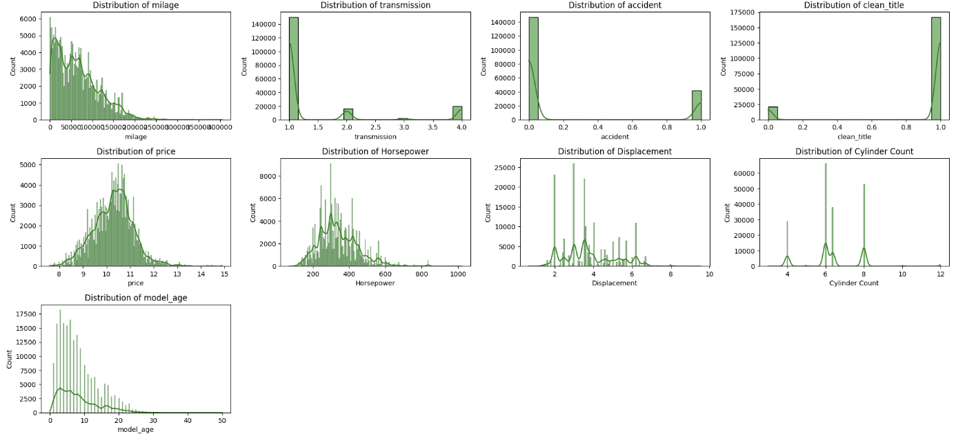
Visualizations Of column Values After Preprocessing
Note: Except For One Hot Encoding and Scaling

Slide 12
Model Development: Linear Regression
Model Performance
Interpretation
The Linear Regression model achieved an RMSE of 0.526 and an R-squared score of 0.61, indicating moderate performance in predicting used car prices.
This baseline model provides insights into linear relationships between features and car prices, serving as a benchmark for more complex models.

Slide 13
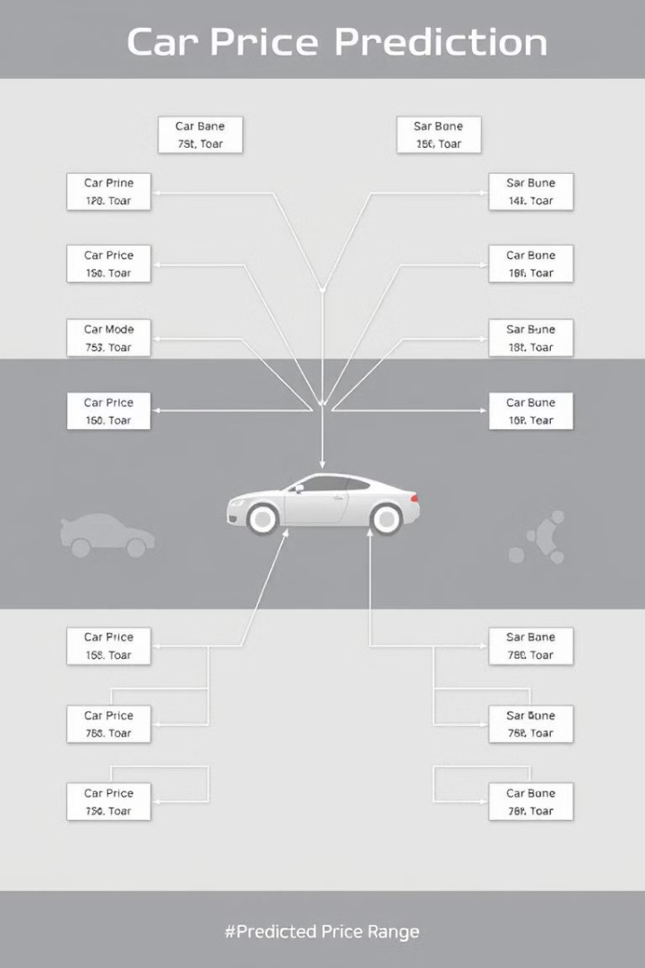
Model Development: Decision Tree
Hyperparameter Tuning
Optimized using RandomizedSearchCV with parameters: min_samples_split=5, min_samples_leaf=10, max_depth=10.
Performance Metrics
Achieved an RMSE of 0.51, MAE of 0.36, and an R-squared score of 0.63.
Model Insights
Demonstrated solid performance in predicting car prices, capturing non-linear relationships in the data.

Slide 14
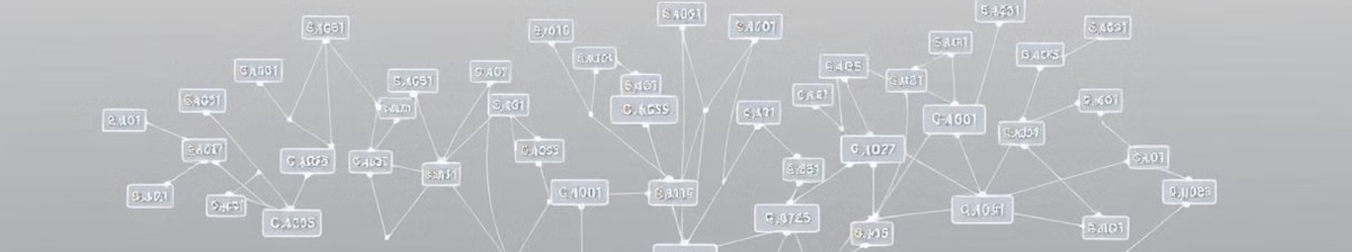



Model Development: Random Forest
Hyperparameter Optimization
Superior Performance
Best Model
Tuned using RandomizedSearchCV: min_samples_split=5, min_samples_leaf=5, max_depth=10.
Achieved RMSE of 69098.21, MAE of 0.35, and R-squared score of 0.65.
Outperformed other models, demonstrating effectiveness in predicting used car prices.

Slide 15

Model Development: Support Vector Regressor (SVR)
1
Initial Implementation
SVR model was trained and optimized as part of the machine learning pipeline.
2
Performance Results
Yielded an RMSE of 71018.67, MAE of 0.42, and R-squared score of 0.53.
3
Comparative Analysis
Showed less predictive power compared to tree-based models in this specific use case.

Slide 16




Conclusion and Future Directions
Best Model
Random Forest outperformed other models in predicting used car prices.
Feature Engineering
Extracting the right features significantly impacted model performance.
Future Improvements
Explore model stacking, incorporate additional data sources, and further refine hyperparameters.
The project successfully developed a machine learning pipeline for predicting used car prices, with the Random Forest model showing the best performance. Future work could focus on expanding the dataset, experimenting with advanced models like XGBoost, and deploying the model in a real-time web application for practical use in the automotive market.

Slide 17
Questions Time

Slide 18
Thank you

